Slide 1
Unit 3
Lecture 5

Slide 2
Entity-Relationship (E-R) Model
• E-R model is a model of the real world. E-R model represents the entities contained in the database. The entities are further described in the database using attributes.
• The relation between the entities is shown using the relationships. The model also shows the cardinality constraints to which the database must adhere to.
• The E-R model is represented diagrammatically using an E-R diagram. Figure below shows a simple E-R diagram.

Slide 3
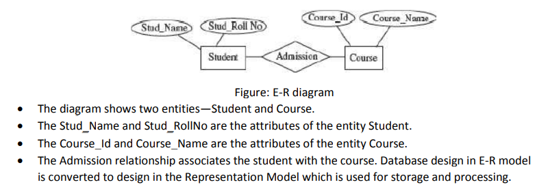

Slide 4
Hierarchical Database Model:
The Hierarchical Database Model was developed by IBM and is the oldest database model. The hierarchical database model is defined as follows:
• The schema of a hierarchical database is represented using a Tree-structure diagram (Figure below).
• The nodes of the tree represent a record type. A line connecting two nodes represents the link.
• The schema is based on parent-child relationship.
• A parent can have none, one, or more children. A child can have only one parent.
• The parent-child relationship is suited for the modeling of one-to-many relationship between two entities.

Slide 5
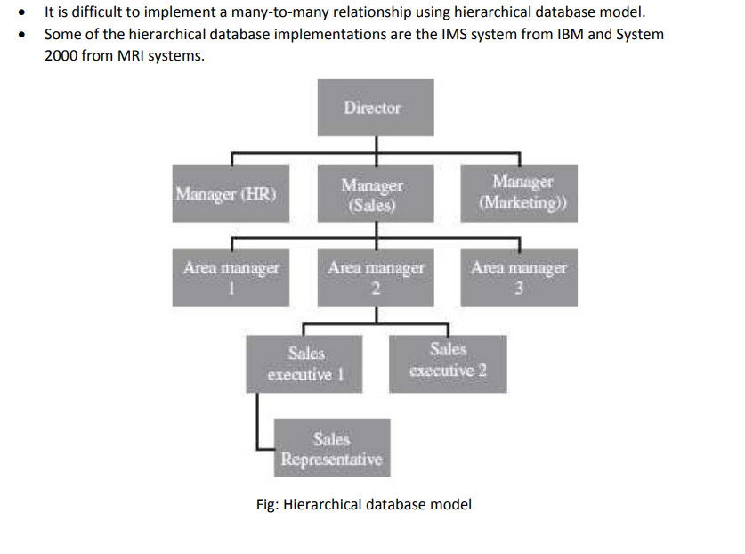

Slide 6
Network Database Model
• The schema of the network database model is represented using a data-structure diagram.
• The boxes represent the record type and the lines represent the links (Figure below).
• The schema is based on owner-member relationship.
• The entity type is represented using record type and relationship between entities is represented using set type.
• The owner-member relationship is suited to represent one-to-many relationships.
• The network model handles many-to-many relationship by converting it into two or more one to- many relationships.

Slide 7
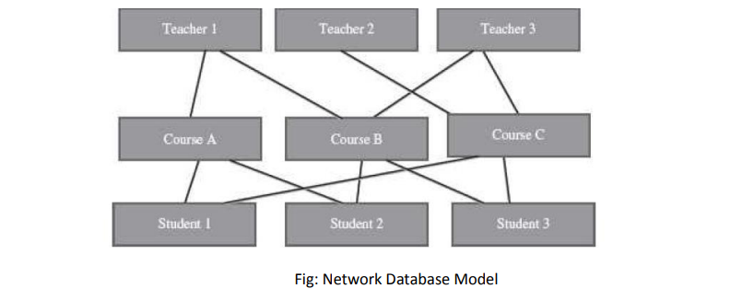

Slide 8
Database System
A bank, hospital, college, university, manufacturer, government are some examples of organizations or enterprises that are established for specific purposes.
All organizations or enterprises have some basic common functions. They need to collect and store data, process data, and disseminate data for their various functions depending on the kind of organization.
Some of the common functions include payroll, sales report etc

Slide 9
A database system integrates the collection, storage, and dissemination of data required for the different operations of an organization, under a single administration.
A database system is a computerized record keeping system. The purpose of the database system is to maintain the data and to make the information available on demand.

